Slide 1


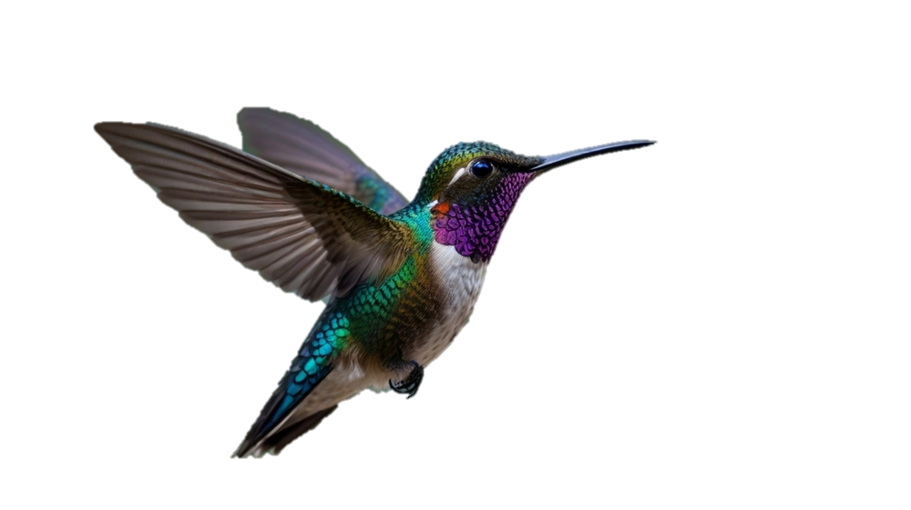


Slide 2


INTRODUCING NEW PROJECT-
THE FUTURE OF POWERED SOLAR CAR ENERGY

Slide 3


Do you know?
Earth is facing a severe, interconnected environmental crisis driven by human activity, primarily climate change, pollution, and biodiversity loss . Global warming is become terrible problem , which is facing by human beings.
most of the people are using vehicles in order to move one place from another . However, it emit harmful gases such as carbon dioxide( co2) , carbon monoxide(CO) and etc. it can cause harmful pollution,

Slide 4
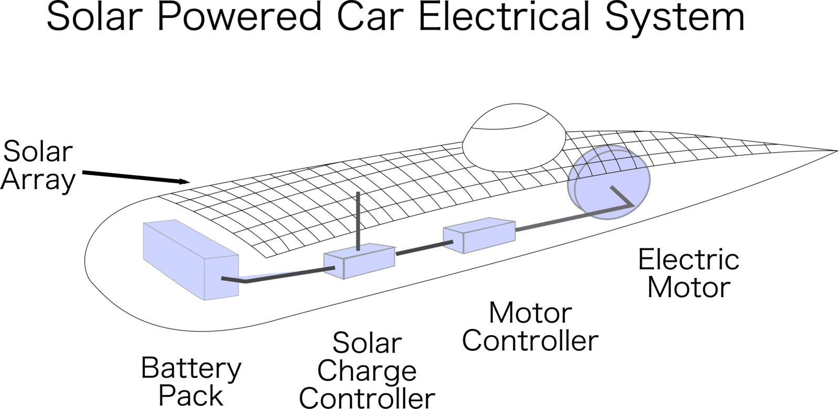

Slide 5
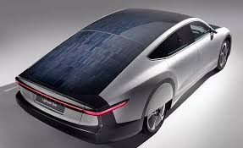
Solar cars are electric vehicles (EVs) that use integrated solar panels to provide full or partial power to the battery.
Because solar power is free, the cost of driving is reduced.
NO
POLLUTION

Slide 6


WITHOUT EARTH, HUMAN BEING’S LIFE IS MEANINGLESS
SOLAR PANEL ‘S CAR IS BEST FOR SUSTAINING THE EARTH’S ECOSYSTEM.

Slide 7


